Slide 1
Classroom Management and Disruptive Behavior

Slide 2
Troubled Student
College students often struggle with a variety of academic and personal concerns.
In the last several years, colleges nationwide have seen a dramatic increase in the number of students with significant emotional and mental health challenges.

Slide 3
Developmental & Situational Stressors
Adjusting to college expectations – first time in college
Lack adequate Reading, Writing, English skills
Lack of good time management and study skills
Living on own for the first time or homelessness
Family and relationship issues
Failure to make satisfactory academic progress
Undiagnosed or unaccommodated disabilities
Financial issues
Unemployment or working multiple jobs
Lack of support system and/or coping skills

Slide 4
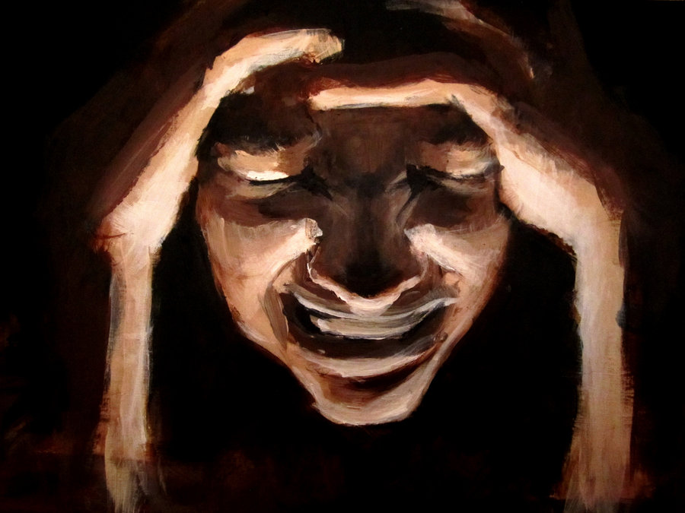
How might Concerns present in the Classroom
Poor attendance or excessive use of services
Sudden outbursts
Attention/memory difficulties
Isolation/withdrawal from others
Changes in mood, irritability, or apathy
Abrupt/radical changes in behavior, including a dramatic decrease in academic functioning
Alcohol or other drug use
Lethargy or sleeping
Marked change in personal hygiene or appearance
Inappropriate crying or hostility
Bizarre and/or suicidal statements or behavior
Writing assignments that express concerns or are disturbing

Slide 5
What Would You Do?
https://www.youtube.com/watch?v=RRYCnNeQgPI
https://www.youtube.com/watch?v=uAWHUk_BjEY
https://www.youtube.com/watch?v=ytFo88fjkjQ
https://www.youtube.com/watch?v=hxgVhHWJwbQ

Slide 6
Center for Student Access
Verify if a student is enrolled with their office
Give Advice:
How to refer to their office
How to manage behavior
How to provide accommodations
Problem solve

Slide 7
Disruptive and Dangerous Behaviors
Disruptive Behaviors
Using smartphones or other technology during class
Frequent interruption of faculty including non-relevant, off-topic questions
Caring on side conversations during classroom lecture
Being under the influence of drugs or alcohol
Entitled or disrespectful talk to faculty or other students
Frequent arguing with faculty and failure to comply with faculty requests
Showing up in strange clothing – military gear or in costumes or wearing a mask
Frequently coming and going from classroom

Slide 8
Disruptive and Dangerous Behaviors
Dangerous Behaviors
Racist or otherwise fixated thoughts – expressed to press buttons
Bullying behavior focused on faculty or students
Direct communicated threat to faculty or other students
Prolonged non-verbal passive-aggressive behavior toward faculty
Self-injurious behavior such as cutting or burning self
Physical assaults, throwing objects, slamming doors or storming out of classroom
Psychotic, delusional, or rambling speech

Slide 9
De-escalating & Defusing Tips
Remove individual from common area
Maintain safe distance from student
Present a calm, supportive demeanor
Listen
Speak clearly and calmly
Become more quiet if individual gets more loud
Show respect and remain non-judgmental
Develop rapport
Express concern
Validate feelings and reflect
Avoid debating
Acknowledge any threats of harm to self or others
Focus on strengths and coping skills
Generate supportive options
Instill a sense of hope
Seek help

Slide 10
STRATEGIES
Listen to the student in a non-judgmental manner.
Express concern for the student’s wellbeing. But be aware of professional boundaries
Identify the student’s behavior or issue impacting their success
Convey support and understanding.
Consult with the counseling staff for guidance.
Encourage the student to follow-up with a counselor. www.lcc.edu/counseling
Explain Counseling is Free and Confidential
Be Mindful of Privacy and FERPA Regulations
For immediate assistance - call LCC Police and Public Safety 517-483-1800
Follow-up with student later to inquire how he/she is doing

Slide 11
Considerations
Safety and Liability - for yourself and campus community
Boundaries - be aware of professional boundaries and limitations
Comfort Level - conflict, emotions, addressing concerns
Empower students to utilize resources and seek help themselves
Teachable moments
Developmentally appropriate tasks
Be Familiar:
Police and Public Safety
Student Code of Conduct
Campus Resources

Slide 12
Suicide Awareness – Know the warning Signs https://suicidepreventionlifeline.org/how-we-can-all-prevent-suicide/
Talking about:
wanting to die or to kill themselves
about feeling hopeless or having no reason to live
feeling trapped or in unbearable pain
about being a burden to others
about seeking revenge Or showing rage
Looking for a way to kill themselves, like searching online or buying a gun
Increasing the use of alcohol or drugs
Acting anxious or agitated; behaving recklessly
Sleeping too little or too much
Withdrawing or isolating themselves
Extreme mood swings
Giving personal items away

Slide 13
Students in Distress
Facilitate a counseling appointment referral
or Consult directly with a counselor (517-483-1924)
- Have student call from your work area to schedule the appointment - Accompany them to Center for Student Support in the StarZone (2nd floor Gannon)
Refer to Student Compliance
File a Behavior Intervention Team (BIT) report about a student of concern
https://lcc.edu/consumer-information/student-compliance/bit.html
File a Conduct report about a Student Code of Conduct violation
https://www.lcc.edu/consumer-information/student-compliance/code-of-conduct.html
File a Title IX report about sexual misconduct
https://lcc-advocate.symplicity.com/titleix_report/index.php/pid738001?
For immediate assistance, call LCC Police and Public Safety (517-483-1800)
- Threat to harm self - Threat to harm others - Severe distress or dysregulation of thought or behavior

Slide 14
Counseling provides a chance to explore feelings and solve problems with the help of an objective, sensitive, concerned listener, who is professionally trained.
Free to all currently-enrolled students.
LCC Counselors are Licensed by Michigan

Slide 15
Counselors Help Students Manage:
Stress
Personal loss
Relationships
Substance abuse
Family matters
Provide support for all circumstances and stressors that affect a student's academic performance.

Slide 16
Counselors Help Faculty:
When you call us, counselors can HELP:
Assess the student’s situation.
Strategize how you can most effectively respond.
Provide campus and community resource options.
Facilitate referrals for counseling and additional support.
Clarify your thoughts and feelings regarding the student’s concerns.

Slide 17
Referrals
Once the student has agreed that counseling might be useful, there are several possible steps to take, depending on the student’s attitude and the urgency of the situation.
Give the student information about Counseling and urge them to call.
Offer to let the student call from your office right then, so that a public commitment will be made.
Accompany the student yourself to make sure he or she arrives at The Center for Student Support, and provide the center with any necessary information.
If the situation feels urgent, a crisis protocol is in place. Call ahead if the student is being brought over or sent directly so that plans can be made to have a counselor available.

Slide 18
How to Reach us
LCC Counselors (located in the Center for Student Support, StarZone Gannon Building 2nd floor):
Pam Davis
Monica DelCastillo
Louise Rabidoux
517-483-1924
Curlada Eure-Harris, designated TRiO Counselor (located in Gannon Building, Room 1225) 517-483-1161
LCC Police and Public Safety (located in Gannon Building, Room 2110 and at West Campus)
517-483-1800 or 911 from any campus phone
Student Compliance (located in Gannon Building, Room 1210)
517-483-1261

